Slide 1
Ultrasonic Peening Solution
Presentation to TRLC for TRL#
Date :
Prepared by: | Approved by:
Name: Raja Zahirudin Raja Ismail Position: Principal Engineer (Pipeline Integrity) Date: | Name: M Fadzil Mustafa Position: Head, Asset Integrity, MX-COE Date:
Internal

Slide 2
Presentation outline
Presentation objective
Executive summary
Background
Workflow
Results
Conclusions & Recommendations

Slide 3
Presentation Objective
To seek TRLC endorsement on the Ultrasonic Peening Solution (UPS) at TRL 7.

Slide 4
Executive Summary
MRA has successfully developed a complete total solution program for stress relief on ferro-magnetic material known as Ultrasonic Peening Solution (UPS).
Ultrasonic Peening Technology
Stress Measurement
Stress Measurement
Ultrasonic Peening Solution
A
Advantages of UPS
Extend material life exposed to fatigue failures, deferring RM millions of CAPEX for asset replacement.
Reduce unplanned operational downtime as problem areas detected and treated online.
Preventing crack formation and growth at stress proned areas.
Require minimal energy requirement, small and versatile for application in remote and tight areas.
Before
Capability of UPS
Increase Fatigue Strength
Increase Corrosion Resistance
Improved Brittle Fracture
Increased Surface Quality
Increase Surface Hardness
Improved Strength of Material
Stress Measurement to gauge effectiveness of treatment
Performs measurement and treatment online
After

Slide 5
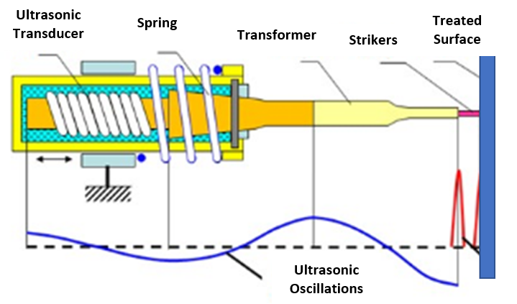
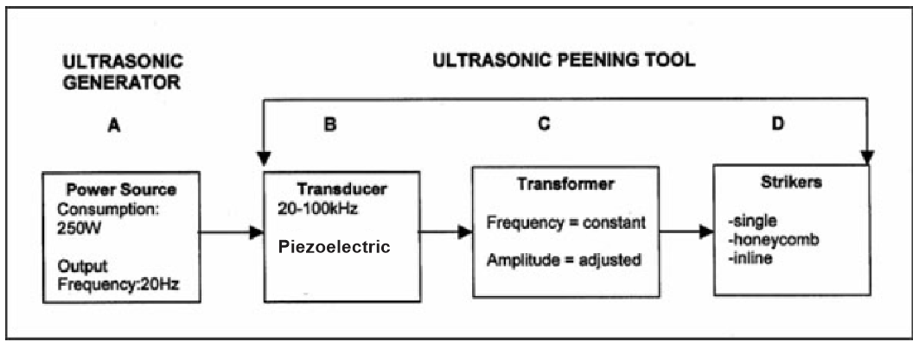
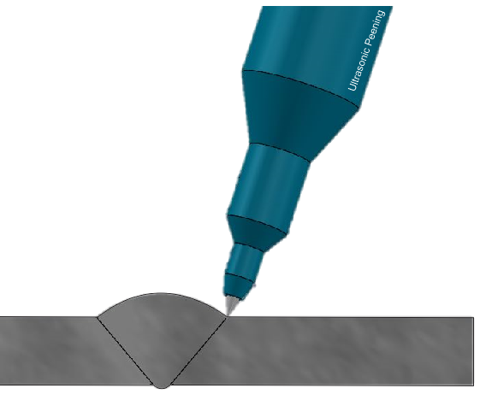
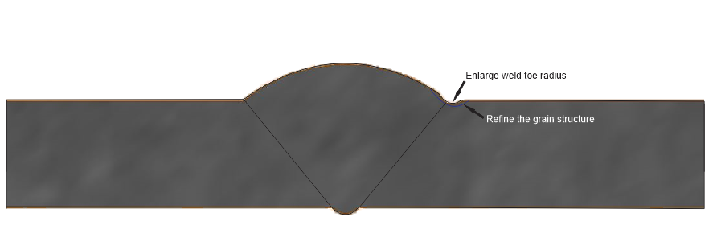
Background-
Fundamental of Ultrasonic Peening Technology
Involve power levels of hundreds of watts only
Amplitudes range from about 10 to 40 microns operating at 20 kHz creates a cyclic acceleration of around 50,000 g (g=9.8 m/s2).
B & C to transmit the ultrasonic oscillations to the treated material
D, strikers made of high-strength materials are used.
A combination effects of high frequency simultaneous exposure to ultrasonic oscillations of the treated surface produce unique beneficial effects to the treated metals and welded component.
Before
After

Slide 6
Background-
Stress Relief Technology Comparison
STRESS RELIEF TECHNOLOGY | STRESS RELIEF TECHNOLOGY
 | TIG DRESSING | GRINDING | HAMMERING | SHOT PEENING | PWHT | ULTRASONIC PEENING
Increase Fatigue Strength | YES | YES | YES | YES | YES | YES
Increase Corrosion Resistance | NO | NO | NO | YES | NO | YES
Decrease Residual Deformation | NO | NO | YES | NO | YES | YES
Decrease Residual Weld Stress | NO | NO | NO | NO | YES | YES
Increase Strength Material | YES | YES | YES | YES | YES | YES
Stress Measurement | No stress measurement for effectiveness and assurance of the treatment

Slide 7
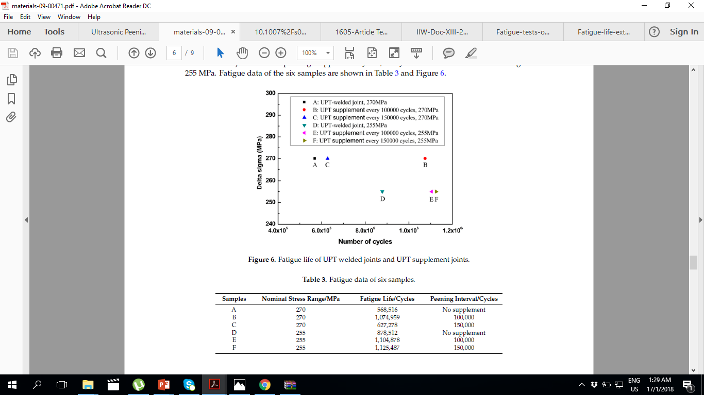
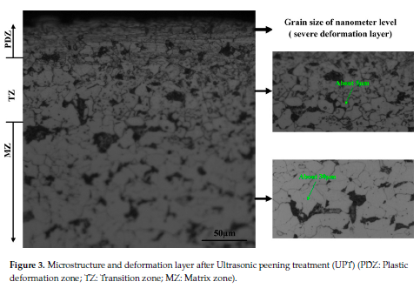
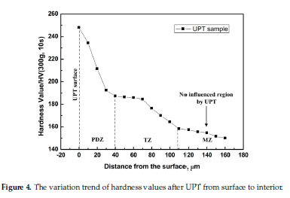
Background-
Ultrasonic Peening Technology Advantages
STRESS RELIEF TECHNOLOGY | STRESS RELIEF TECHNOLOGY
 | ULTRASONIC PEENING | EVIDENCE
Increase Fatigue Strength | YES
Increase Surface Hardness & Corrosion Resistance | YES
Xiaohui Zhao 1, Mingyi Wang 1, Zhiqiang Zhang 1,* and Yu Liu 2 “The Effect of Ultrasonic Peening Treatment on Fatigue
Performance of Welded Joints” MDPI Journal 2016

Slide 8
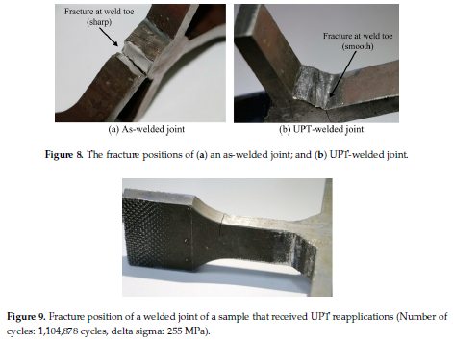
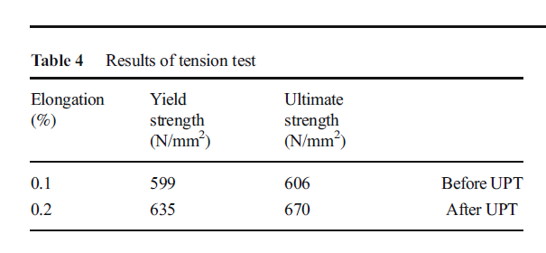
Background-
Ultrasonic Peening Technology Advantages
STRESS RELIEF TECHNOLOGY | STRESS RELIEF TECHNOLOGY
 | ULTRASONIC PEENING | EVIDENCE
Improve Brittle Fracture Resistance | YES
Improve Strength of Material | YES
Xiaohui Zhao 1, Mingyi Wang 1, Zhiqiang Zhang 1,* and Yu Liu 2 “The Effect of Ultrasonic Peening Treatment on Fatigue
Performance of Welded Joints” MDPI Journal 2016
Alireza Abbasi 1 & Saeid Amini 1 & Ghanbar Ali Sheikhzadeh1
“Effect of ultrasonic peening technology on the thermal fatigue
of rolling mill rolls” International Journal of Manufacturing Technology

Slide 9
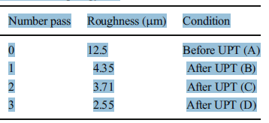
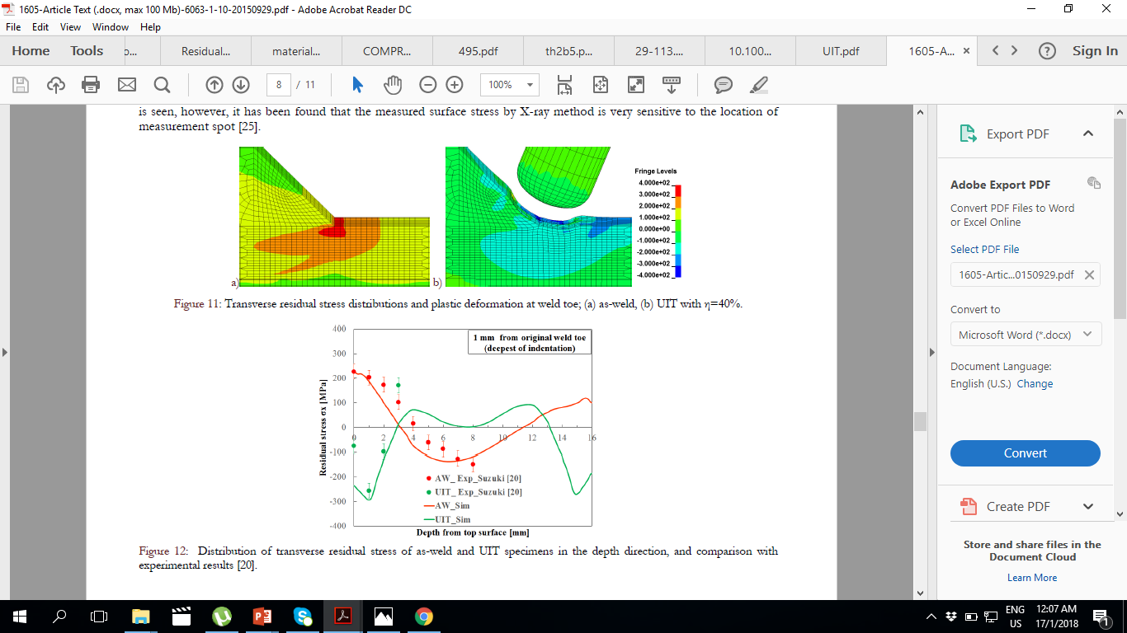
Background-
Ultrasonic Peening Technology Advantages
STRESS RELIEF TECHNOLOGY | STRESS RELIEF TECHNOLOGY
 | ULTRASONIC PEENING | EVIDENCE
Increase Surface Quality | YES
Decrease Residual Weld Stress | YES
Stress Measurement | No stress measurement for effectiveness and assurance of the treatment
Alireza Abbasi 1 & Saeid Amini 1 & Ghanbar Ali Sheikhzadeh1
“Effect of ultrasonic peening technology on the thermal fatigue
of rolling mill rolls” International Journal of Manufacturing Technology
K.L. Yuan et alii, Frattura ed Integrità Strutturale, 34 (2015) 476-486; DOI: 10.3221/IGF-ESIS.34.53 «Modelling of ultrasonic impact treatment (UIT) of welded joints and its effect on fatigue strength”

Slide 10
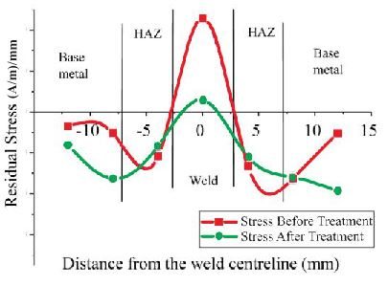
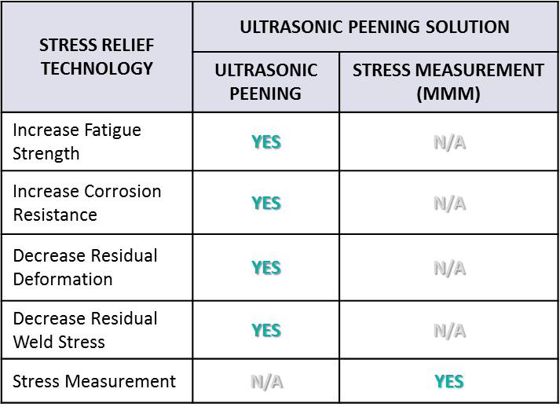
Ultrasonic Peening Solution
Ultrasonic Peening Solution (UPS) is a method to improve and rehabilitate the material to its best possible state based on:
  Increase surface hardening of the material
  Refine the material grain structure.
  Increase of material life-span.
  The inclusion Stress Measurement (MMM) in the UPS enables the effectiveness of Ultrasonic Peening Technology to be measured in-situ without the need of destructive or lab-testing.

Slide 11
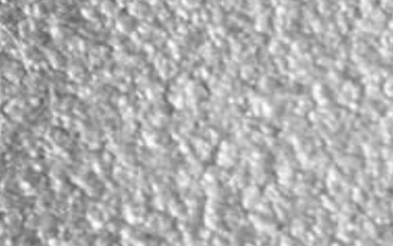


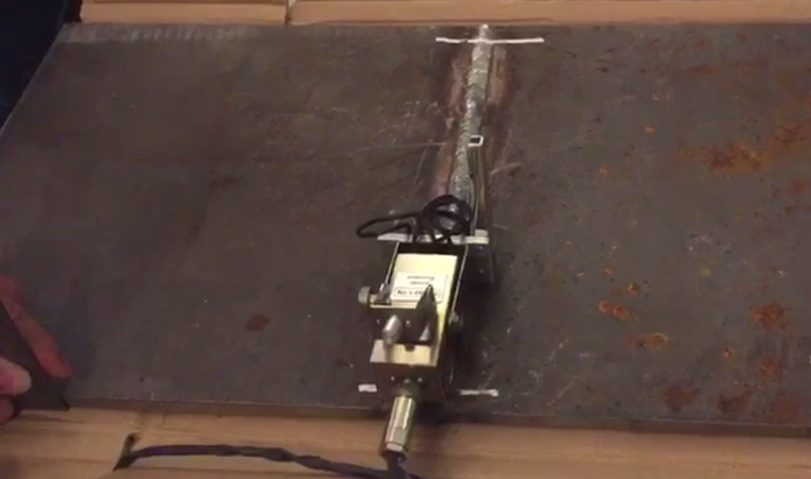
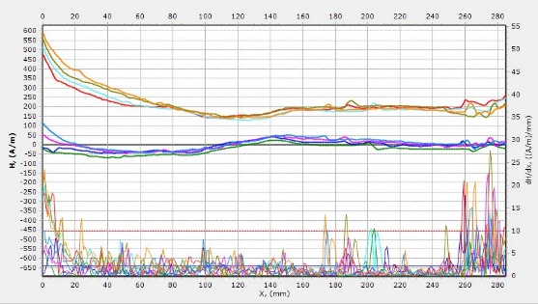
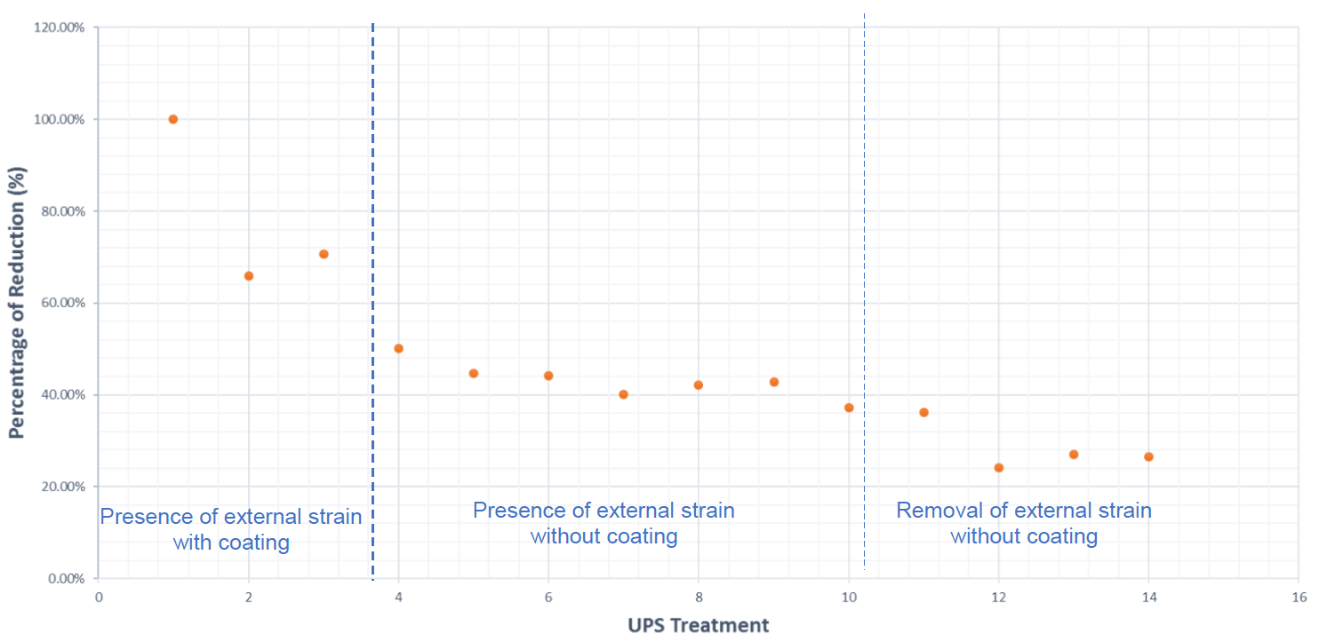
Workflow
STAGE 1
Pre-Stress Measurement
STAGE 2
Ultrasonic Peening Treatment
STAGE 3
Post Stress Measurement
STAGE 4
Report Preparation
Original surface of spring steel "as received“ condition.
Magnication 8x.
Surface of spring steel after treatment with the UPS technique with “Treatment A“ conditions. Magnication 8x.
Surface of spring steel after treatment with the UPS technique with “Treatment B“ conditions. Magnication 8x.
Surface Roughness Measurement Results:
“as received” condition
6.6 ± 2.1 Ra(μ)
After UPS treatment for shorter time
4.4 ± 0.4 Ra(μ)
After UPS treatment for longer time
2.9 ± 0.3 Ra(μ)
Advantages after Treatment A & Treatment B:-
It improves the quality of the surface
It increases the hardeness of surface and corrosion resistance
It improve the fatigue life of the spring steel

Slide 12
Component TRL Analysis (Metal Magnetic Memory, MMM)
No. | Component | TRL | TRL Description
1 | Metal Magnetic Memory for Stress Measurement at Ferrous Material | 7 | The technology has been implemented in various application as a stress technology measurement especially: Welding Parent metal Both work in Malaysia and international for more than 3 years
No. | Specification/ Qualification Factor System | Work Activities Required | Test Conducted | Result Achieved
1 | Metal Magnetic Memory for Stress Measurement at Ferrous Material | Commercial activities 1.Inspection carried out at MLNG,PGB, PCSB | MLNG-Slugcatcher 1 Objective: to conduct inspection in identifying pitting corrosion at MLNG Slugcather 1 area based stress assessment. 2. PGB-TSET Objective; to conduct stress based inspection work for insulated piping. 3. PCSB Objective: Welding Assessment in identifying most stress concentration zones location using MMM at PC4 location | List of results achieved: •Resolved problem in pitting corrosion identification at MLNG •Resolved problem in identifying area of concern occur under insulated piping. •Resolved problem in identifying most concentrated stress area due to poor welding quality at PC4 location.

Slide 13
Component TRL Analysis (Ultrasonic Peening Technology, UPT)
No. | Component | TRL | TRL Description
1 | Ultrasonic Peening Technology for Stress Relief Technology | 7 | The technology was tested in various application as a stress relief technology : Welded Joint Parent metal
No. | Specification/ Qualification Factor System | Work Activities Required | Test Conducted | Result Achieved
1 | Ultrasonic Peening Technology for Stress Relief Technology | Commercial Work: FPSO Structure | The technology was conducted at various FPSO structure especially on welded joint. | List of results achieved Fatigue Life Extension by Ultrasonic Peening (Martinez, 2011) Martinez, L. L. (2011). Life Extension of FPSO Structural Detail Using Ultrasonic Peening.

Slide 14
Component TRL Analysis (Ultrasonic Peening Solution, UPS)
No. | Component | TRL | TRL Description
1 | Ultrasonic Peening Solution for Stress Relief and Measurement Technology | 7 | The technology was tested in several field trial conducted: Welded Joint (RSRM Ultrasonics GmbH) Parent metal (Petronas COE)
No. | Specification/ Qualification Factor System | Work Activities Required | Test Conducted | Result Achieved
1 | Ultrasonic Peening Solution for Stress Relief and Measurement Technology | Commercial Work: Commercial work are carried out at RSRM Ultrasonics GmbH c/o Eberli Sarnen AG Feldstrasses 2, 6060 Sarnen, SWITZERLAND Inspection is carried out at MRA International Sdn Bhd Cyberjaya To compare the efficiency of Ultrasonic Peening Solution. | RSRM Ultrasonics GmbH: Objective: to assess the reduction of stress condition after UPS treatment at welded joint 2. MRA International: Objective: to assess the reduction of stress condition after UPS treatment at parent metal | List of results achieved 1. UPS manages to reduce stress concentration zone areas up to 80% at the welded joint area. 2. UPS manages to reduce stress concentration zone areas up to 80% on parent metal.

Slide 15
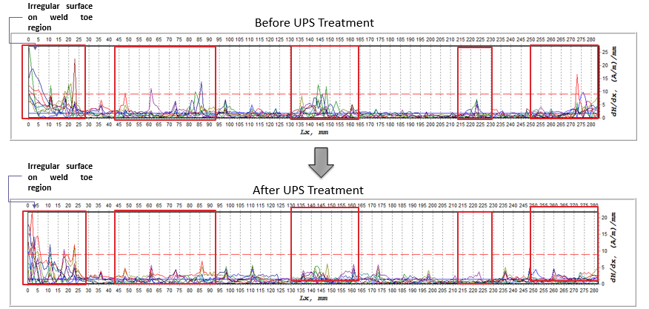
UPS Deployment Result
Project | Fatigue Life Extension of FPSO Structure by Ultrasonic Peening Solution
Contractor | RSRM Ultrasonic GmbH c/o Eberli Sarnen AG, Feldstrasse 2, 6060 Sarnen, Switzerland | Location Project |  | 190 km east of the city of Aberdeen, Scotland
Objective | To extend the fatigue life of the pallet stool brackets on the cargo deck
Result | UPS was used on the side welds of the shape modified bracket, to ensure crack would not occur there. UPS increases fatigue life of a weld by up to five times when compared to the fatigue life in the as-welded condition. The weld quality uncertainties if any, could be then improved by the ultrasonic peening treatment.
Advantages | Preventing fatigue cracking and maintain the structural integrity UPS extended fatigue life of the treated welded five time UPS save time and money

Slide 16
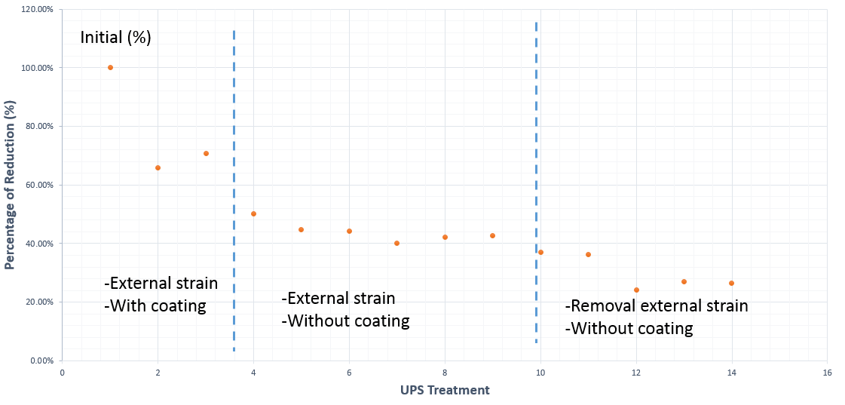
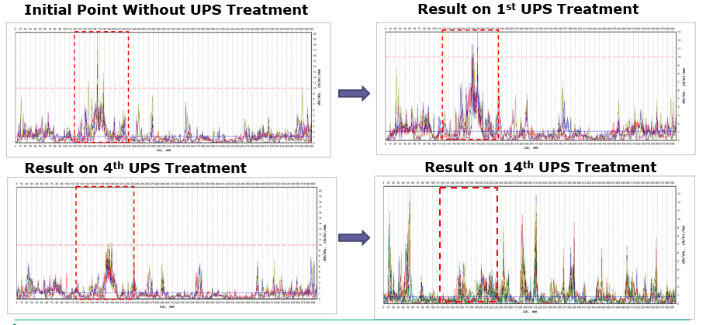
UPS Deployment Result
Project | Ultrasonic Peening Field Trial
Contractor | MRA International Sdn Bhd | Location Project |  | Cyberjaya
Objective | To determine critical stress concentration zones (SCZs) area on the parent metal utilizing Stress Measurement method. To conduct stress relief treatment on the critical SCZs location using Ultrasonic Peening. To determine the effectiveness of Ultrasonic Peening in reducing the critical SCZs location.
Result | UPS successfully to reduce stress concentration zone areas up to 80% on parent metal.
Advantages | UPS reduce the residual stress occur on parent metal by 80%. Reduction of stress value is significant with removal of external strain and coating removal UPS improve the strength of the parent metal and increase the hardness of the parent metal UPS can increase fatigue strength of the parent metal UPS can improve of brittle fracture of the parent metal UPS can increase of corrosion resistance in the parent metal

Slide 17
Conclusions & Recommendations
UPS is successfully developed, tested and qualified as a solution that provides assurance in stress relief on ferro-magnetic material especially for welded joint and parent metal area.
TRLC to endorsed the UPS at TRL 7.

Slide 18
Thank You
Internal

Slide 23
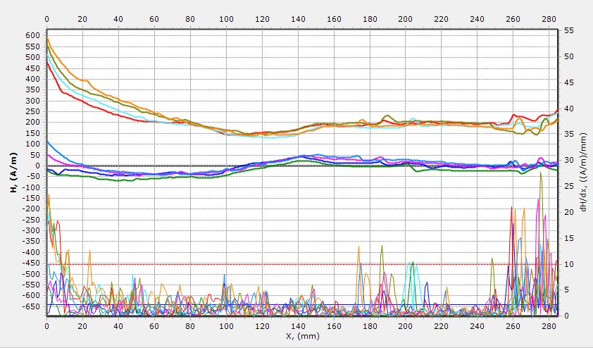

Slide 25
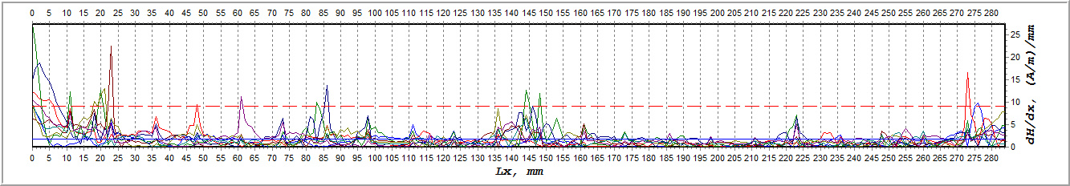
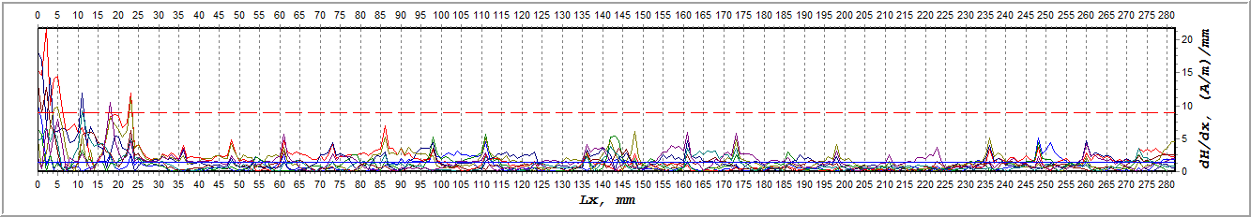
Result / Finding
Irregular surface on weld toe region
Before UPS Treatment
Irregular surface on weld toe region
After UPS Treatment

Slide 26
Result / Finding

Slide 27
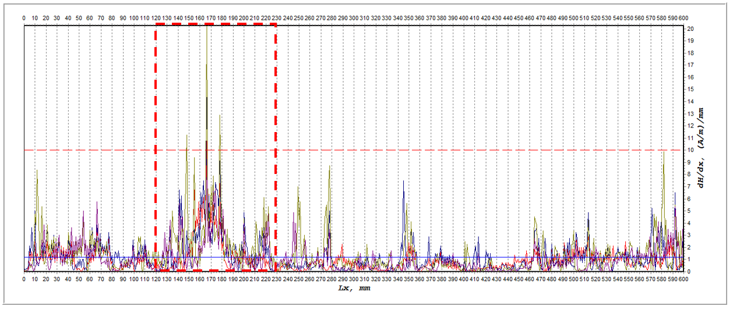
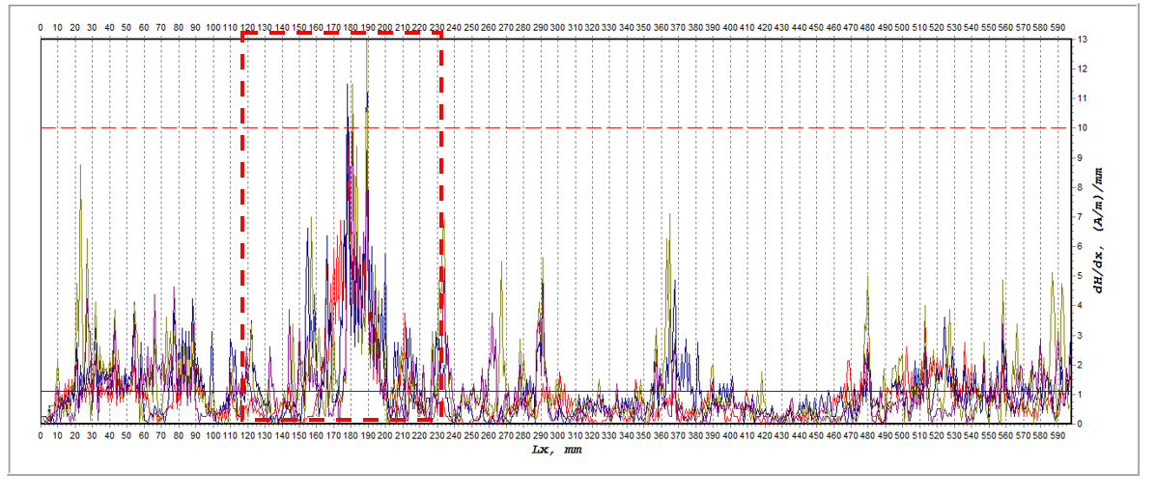
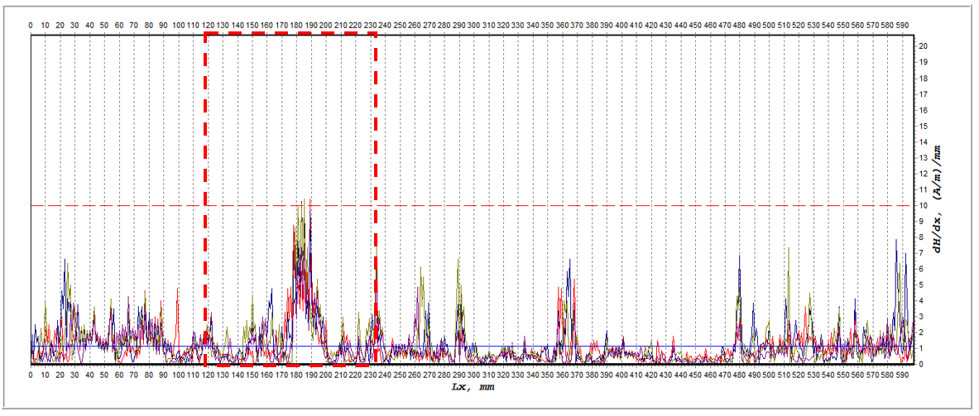
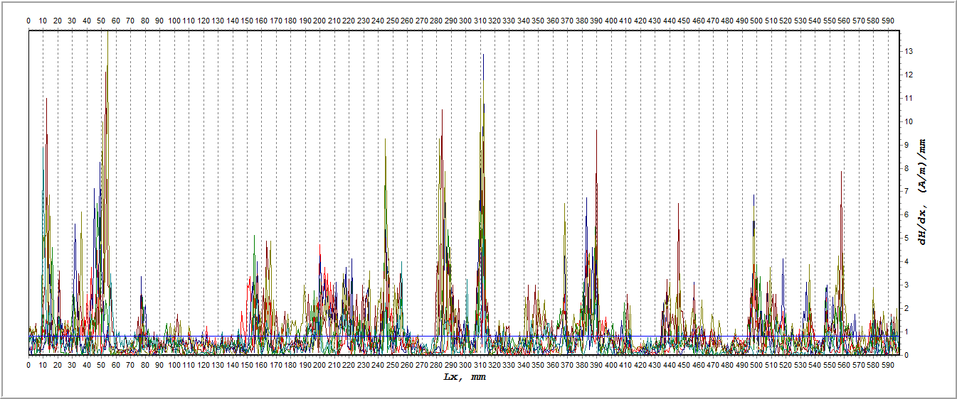
Result / Finding
Initial Point Without UPS Treatment
Result on 1st UPS Treatment
Result on 4th UPS Treatment
Result on 14th UPS Treatment

